Slide 1
Prokaryotes & Eukaryotes
Dr. Gary Mumaugh

Slide 2
Life Forms: Overview
Prokaryotes & Eukaryotes: Introduction & Assessment
Similarities and Differences between Prokaryotes & Eukaryotes

Slide 3
Characteristics of Cellular Life
Cell Organization
Three Basic Parts of a Cell
Membrane (selectively porous both inside and out)
DNA region (located within a nucleoid or nucleus)
Cytoplasm & subcell parts, otherwise known as organelles

Slide 4
Minimal Requirements for Life
Cell membrane that separates outside from inside
A cell without a membrane is, by definition, not a cell
All cells have DNA as basic genetic material
All cells are composed of the same basic chemicals: carbohydrates, proteins, nucleic acids, minerals, fats and vitamins
All cells maintain some level of consistency with regard to the flow of nutrients and wastes that enter and leave the cell

Slide 5
All cells have the ability to reproduce and are the by-product of reproduction
All cells need a steady stream of energy
All cells have extensive sensory systems
This information is regularly processed so that important metabolic decisions may be made in a timely manner

Slide 7
Prokaryotes: Introduction
Prokaryotic cells are the more primitive
Less complex than eukaryotic cells
Prokaryotes contain fewer organelles
Original inhabitants of this planet
Reputation for being the toughest of the tough
They outlast all other living things in terms of being able to withstand the cold, heat, acidity and other extreme conditions including pressure and altitude

Slide 8
Prokaryotes
Two forms: Archaea and Bacteria
Difference is in the structure of their cell walls
Prokaryotes are unicellar
They lack a cell nucleus and other membrane-bound organelles
While the great majority of prokaryotes are bacteria, the two terms are often used interchangeably

Slide 10
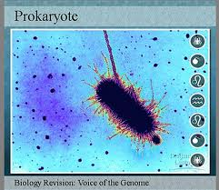

Slide 11
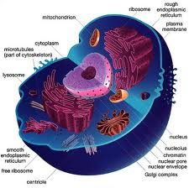
Eukaryotes
Organisms with a membrane-bound nuclei
Mostly in multi-cellular form (known as protests)
Eukaryotes are found within animals, plants and fungi

Slide 12
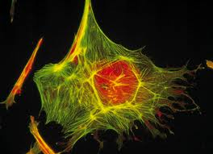

Slide 13
Structural Differences Between Prokaryotes and Eukaryotes
Prokaryotes
Lack a nucleus and membrane-bound cell compartments
They do have cell walls
Smaller than eukaryotes
Contain a single loop of DNA stored in an area named the nucleoid
Higher metabolic rate & a higher growth rate

Slide 14
Eukaryotes
Have a well defined nucleus
Much larger than prokaryotes by typically a thousand times by volume
Have a variety of internal membranes and structures called organelles
Has a cytoskeleton composed of microtubules and microfilaments
DNA is divided into several bundles called chromosomes

Slide 15
What Eukaryotes Have That Prokaryotes Do Not Have:
Division of cells into nucleus and cytoplasm separated by nuclear envelope
Complex chromosomes comprised of DNA
Complex membranous cytoplasmic organelles
Complex flagella and cilia
Capable of ingesting fluid and certain materials within enclosed sacs
Cellulose containing cells
Cell division
Two copies of genes per cell
Sexual reproduction involving meiosis and fertilization

