Slide 1
Digestive System Infections
Dr. Gary Mumaugh

Slide 2
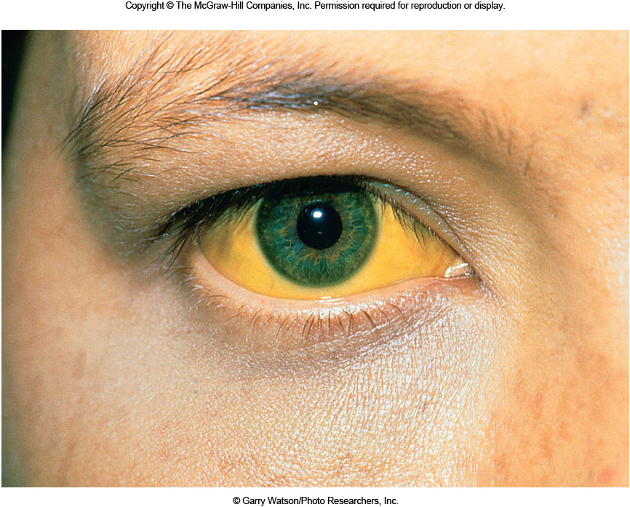

Slide 3
Digestive System Infections
Sometimes referred to as the alimentary or gastrointestinal tract
Passageway running from mouth to anus
One of the body’s boundaries from the environment
Major route of microbial invasion
Main purpose to provide nutrients to body
Divided into upper and lower tracts

Slide 4
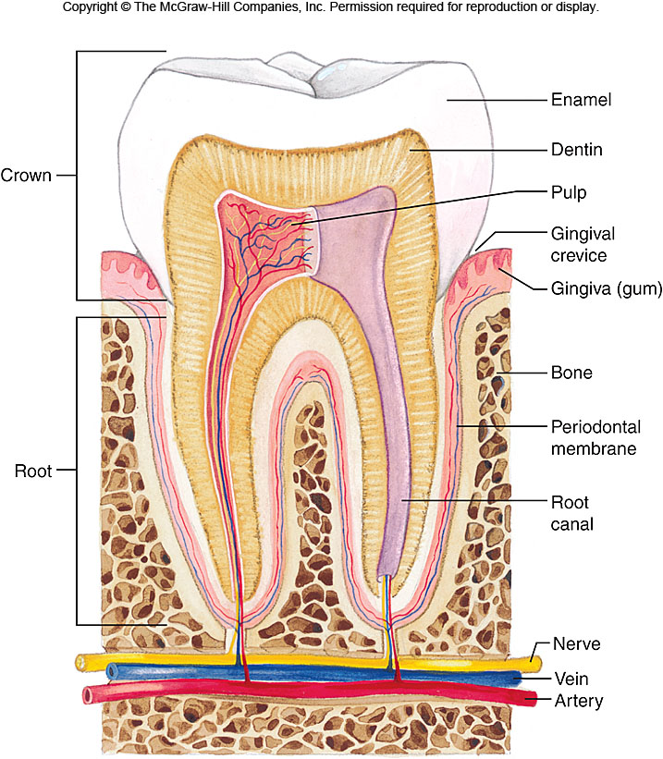
Normal Microbiota
Important in protecting body from invasion
Flora of digestive tract mainly found in the oral cavity and intestines
Esophagus has very little flora
Normal stomach is devoid of microorganisms
Killed by stomach acid

Slide 5
Normal Microbiota
Mouth
Relatively few species colonize oral cavity
Streptococcal species most common
Host limits number of bacteria on mucous membranes
Membrane cells constantly shedding
Teeth are nonshedding surface
Large numbers of bacteria can collect and form biofilm
Masses of bacteria termed dental plaque

Slide 6
Normal Microbiota
Intestines
Small number of bacteria colonize upper small intestine
Large intestine contains very high numbers of organisms
Approximately 10¹¹ bacteria per gram of feces
That is 100 billion bacteria!!!!!
High population is due to abundance of nutrients in feces
Escherichia coli and other enterobacteria predominate bacterial population
Important source of opportunistic infections
Especially of the urinary tract
Normal intestinal flora prevent pathogenic colonization of large intestine

Slide 7
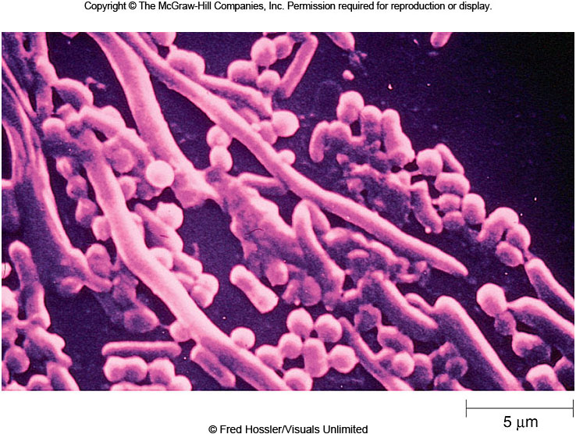

Slide 8
Bacterial Disease of the Upper Digestive Tract
Most common human diseases occur in the mouth
Bacterial infections of the stomach are very uncommon
When infections do occur they can lead to ulcers
Oral flora can enter bloodstream during dental procedures
Can cause sub-acute bacterial endocarditis
Chronic gum infections play role in arterial sclerosis and arthritis

Slide 9
Dental Caries
Most common infectious disease of human beings
Main reason for tooth loss
As many as 47% of US population over 65 have lost all of their teeth
Symptoms
Usually advanced before symptoms arise
Once symptoms develop they include
Throbbing pain
Noticeable discoloration, roughness or defect in tooth
Tooth can break while chewing

Slide 10
Dental Caries
Causative Agent
Streptococcus mutans most common cause
Colonize teeth
Cannot colonize mouth
Thrive in acidic conditions
Produce lactic acid from sugar metabolism
Produce glucans from sucrose
Glucans essential for production of dental caries

Slide 11
Dental Caries
Pathogenesis
Begins with adherence of bacteria to specific receptors on teeth
Production of glucans from dietary sucrose
Glucans bind organisms together and to tooth
Formation of cariogenic plaque
Dietary sugar produces drop in pH
Acidic environment causes calcium phosphate in teeth to dissolve, which creates pits and fissures for colonization

Slide 12
Dental Caries
Prevention
Restriction of dietary sucrose
Most important preventative
Fluoride required for teeth to resist acid
Makes tooth enamel harder
More resistant to dissolving in acid

Slide 13
Dental Caries
Treatment
Mechanical removal of plaque via tooth brushing and dental floss
Reduces incidence by approximately 50%
Pits and fissures prevented by application of sealant
Treatment of caries requires drilling out cavity and filling with amalgam

Slide 15
Periodontal Disease
Symptoms
Majority of cases asymptomatic
Common symptoms
Bleeding gums
Gum sensitivity
Bad breath
Teeth become loose and discolored
Receding gums
Causative agent
Caused by dental plaque
Plaque forms at area where gum joins the teeth
Numerous bacteria reside in plaque

Slide 16
Periodontal Disease
Pathogenesis
Plaque forms on teeth at gum line often referred to as tartar
Extends into gingival crevice
Inflammation occurs known as gingivitis
Progression results from enzymes released from organisms that weaken gingival tissue
Causes gingival crevice to widen and deepen
Gram-negative organisms increase and release exotoxins
Exotoxins attack host tissue
Membranes and bone softens
Tooth may be lost

Slide 17
Periodontal Disease
Epidemiology
Mainly disease of individuals over 35
90% of those over 65 have some periodontal disease
People with underlying immunodeficiency often have severe disease
Prevention and treatment
Careful flossing and brushing
Combined with semi-annual polishing and cleaning
Treated by cleaning out inflamed gingival crevice and removing plaque
In advanced cases surgery is usually required

Slide 18
Trench Mouth
Also known as Vincent’s disease or
acute necrotizing ulcerative gingivitis
ANUG
Condition distinct from other forms of periodontitis
Disease rampant during World War I
Soldiers in trenches unable to attend to proper mouth care

Slide 20
Trench Mouth
Symptoms
Abrupt onset
Fever
Bleeding and painful gums
Foul odor
Causative agent
Oral spirochete from Treponema genus
Bacteria most likely work synergistically with other anaerobic bacteria of mouth

Slide 21
Trench Mouth
Pathogenesis
Precise mechanism unknown
Presumed to act with other bacteria to destroy tissue
Plaque is always present
Bacterial invasion causes necrosis and ulceration
Mainly of gums between teeth

Slide 22
Trench Mouth
Prevention and Treatment
Control directed at daily brushing and flossing
With semi-annual cleaning
Antibacterial treatment directed at spirochetes and anaerobic bacilli
Relives acute symptoms
Must be followed up with extensive plaque removal
Epidemiology
Can occur at any age
Arises in association with poor dental hygiene
Stress, malnutrition or immunodeficiency may contribute
Disease not contagious

Slide 23
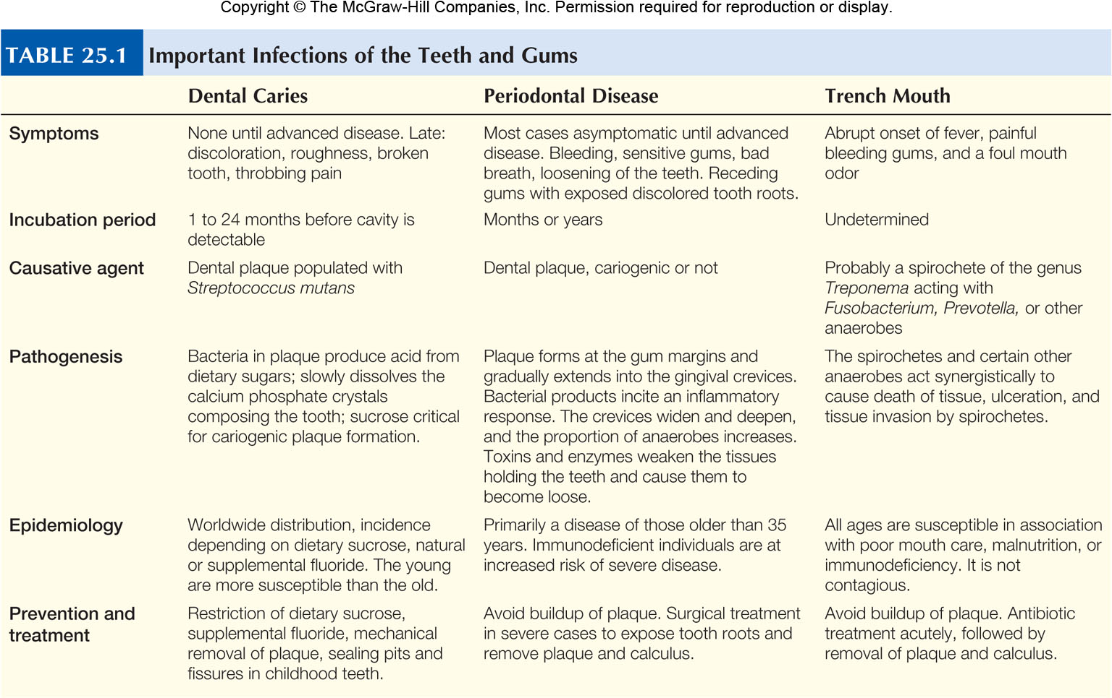
Trench Mouth

Slide 24
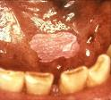
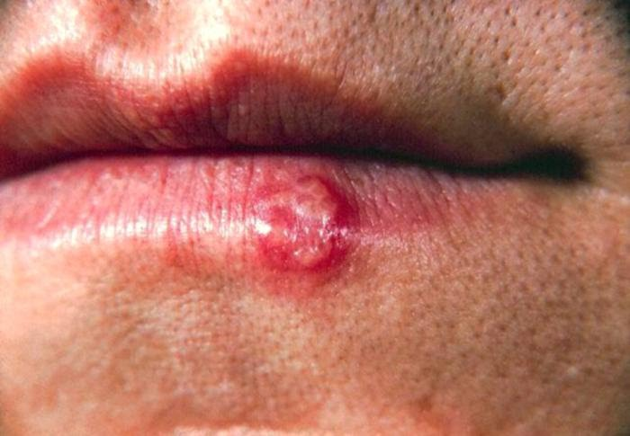
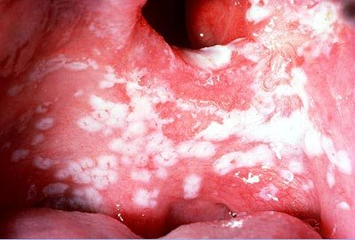

Slide 25
Helicobacter pylori Gastritis
Symptoms
Range from belching to vomiting
Most are asymptomatic
Symptoms occur when infection is complicated with ulcers or cancer
Symptoms include
Abdominal pain
Tenderness
Bleeding
Causative Agent
Helicobacter pylori

Slide 26
Helicobacter pylori Gastritis
Pathogenesis
Bacteria survive extreme acidity of the stomach
Able to neutralize environment
Organism uses flagella to corkscrew through mucosal lining
Inflammatory response begins
Mucus production decreases
Without mucus stomach lining not protected from acidic environment
Infection persists for years
Possibly for a lifetime

Slide 27
Helicobacter pylori Gastritis
Epidemiology
Infections tend to cluster in families
Transmission most likely fecal-oral route
Flies also capable of transmission
20% of US population infected
Incidence increases with age
Almost 80% of those over 75 infected
Rates highest in lower socioeconomic groups

Slide 28
Helicobacter pylori Gastritis
Prevention and Treatment
No proven prevention measures
Infection can usually be eradicated with combined antibiotic treatment
Medication is also used to inhibit production of stomach acid

Slide 29
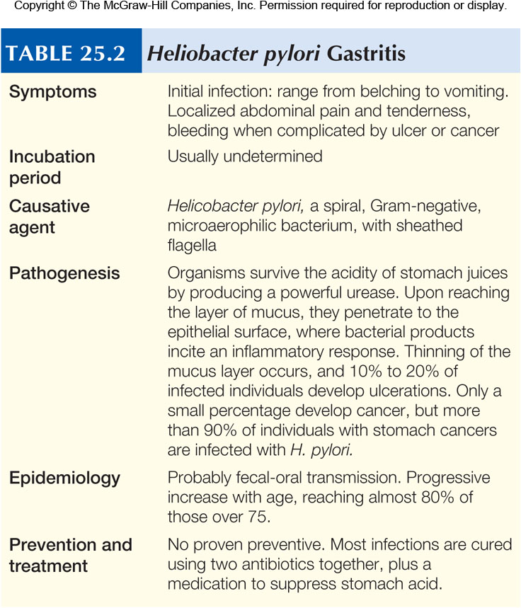
Helicobacter pylori Gastritis

Slide 30
Benign Gastric Ulcer

Slide 31
Deep Gastric Ulcer

Slide 32
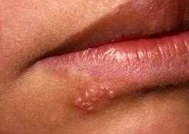
Herpes Simplex
Extremely widespread disease
Many manifestations
Most common form begins in mouth and throat
Infection persists for life
Virus transmissible with saliva
Disease usually insignificant
Disease can be fatal in immunodeficiency

Slide 33
Herpes Simplex
Symptoms
Typically begin during childhood
Common symptoms include
Fever and blisters
First lesions which lead to ulcers
Ulcers in mouth and throat
Generally painful
Heal without treatment
After healing disease becomes latent
Symptom recurrence usually begins on the lips
Marked by tingling, itching, burning or painful sensation

Slide 34
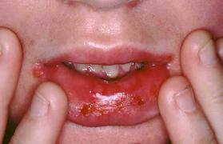
Herpes Simplex
Causative Agent - Herpes simplex virus (HSV)
Two types
HSV 1
Occurs mainly on the lips and mouth
HSV 2
Responsible for most genital infections

Slide 35
Herpes Simplex
Pathogenesis
HSV 1
Virus multiplies in epithelial cells of mouth or throat
Blisters form
Blisters contain large numbers of mature virions
Some virions carried to lymph vessels and nodes
Immune response produced limits infection
Some virions enter sensory nerves as latent virus
Latent virus can become infectious
Viruses are carried by nerves to skin or mucous membranes
Viruses produce recurrent disease
Stress can precipitate recurrences

Slide 36
Herpes Simplex
Epidemiology
Extremely widespread
Infects 90% of some US inner-city populations
Estimated 20% to 40% of Americans suffer from recurrent disease
Transmitted by close physical contact
Virus can survive for several hours on plastic and cloth
Greatest risk of transmission is contact with lesion or infected saliva

Slide 37
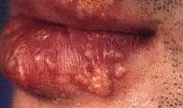
Herpes Simplex
Prevention and Treatment
Antivirals such as acyclovir have proved effective in treatment

Slide 39
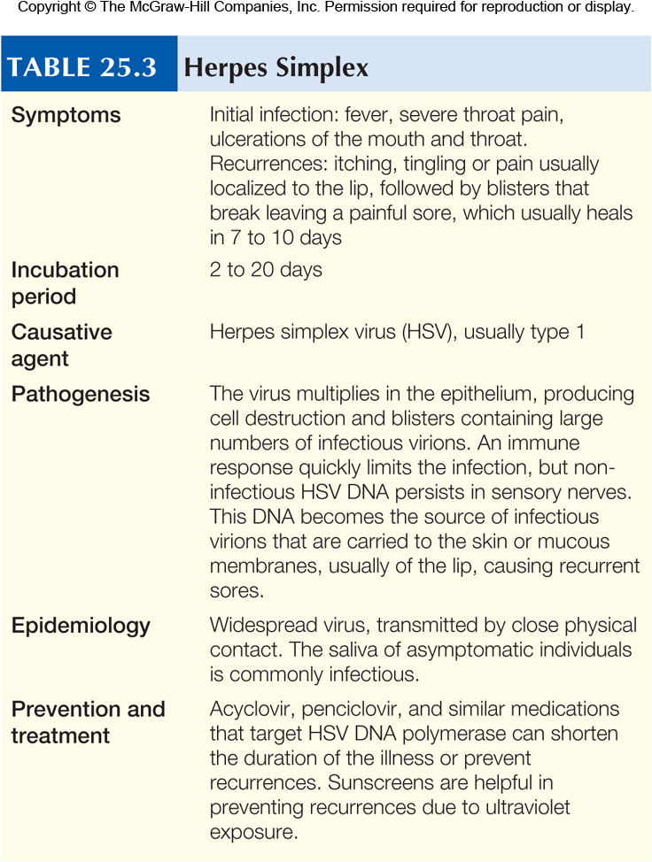
Herpes Simplex

Slide 40
Cholera
Symptoms
Classic example of severe diarrhea
Can amount to loss of 20 liters of fluid per day
Often termed “rice water stools” due to appearance
Vomiting common in most cases
Usually occurs at the onset of disease
Many suffer muscles cramps
Caused by loss of fluid and electrolytes

Slide 41
Cholera
Causative Agent - Vibrio cholerae
Tolerates high alkaline environment
Pathogenesis
Large numbers must be ingested to effect disease due to sensitivity to stomach acid
In small intestine, organisms adhere to epithelial lining and multiply there
Pathogenesis
Bacteria-produced toxin
Cholera toxin
Responsible for symptoms

Slide 42
Cholera
Epidemiology
Fecal contamination of water most common source of transmission
Crabs and vegetable fertilized with human feces have also been implicated
Person with cholera may discharge at least 1 million bacteria per milliliter of feces

Slide 43
Cholera
Prevention
Depends largely on
Adequate sanitation
Availability of safe water supplies
Travelers should cook food immediately before eating
Fruit should be peeled personally
Avoid ice unless made with boiled water

Slide 44
Cholera
Treatment
Treatment depends on rapid replacement of fluids and electrolytes
Essential before irreversible damage to vital organs
Replacement of fluids and electrolytes decreases mortality to less than 1%

Slide 45
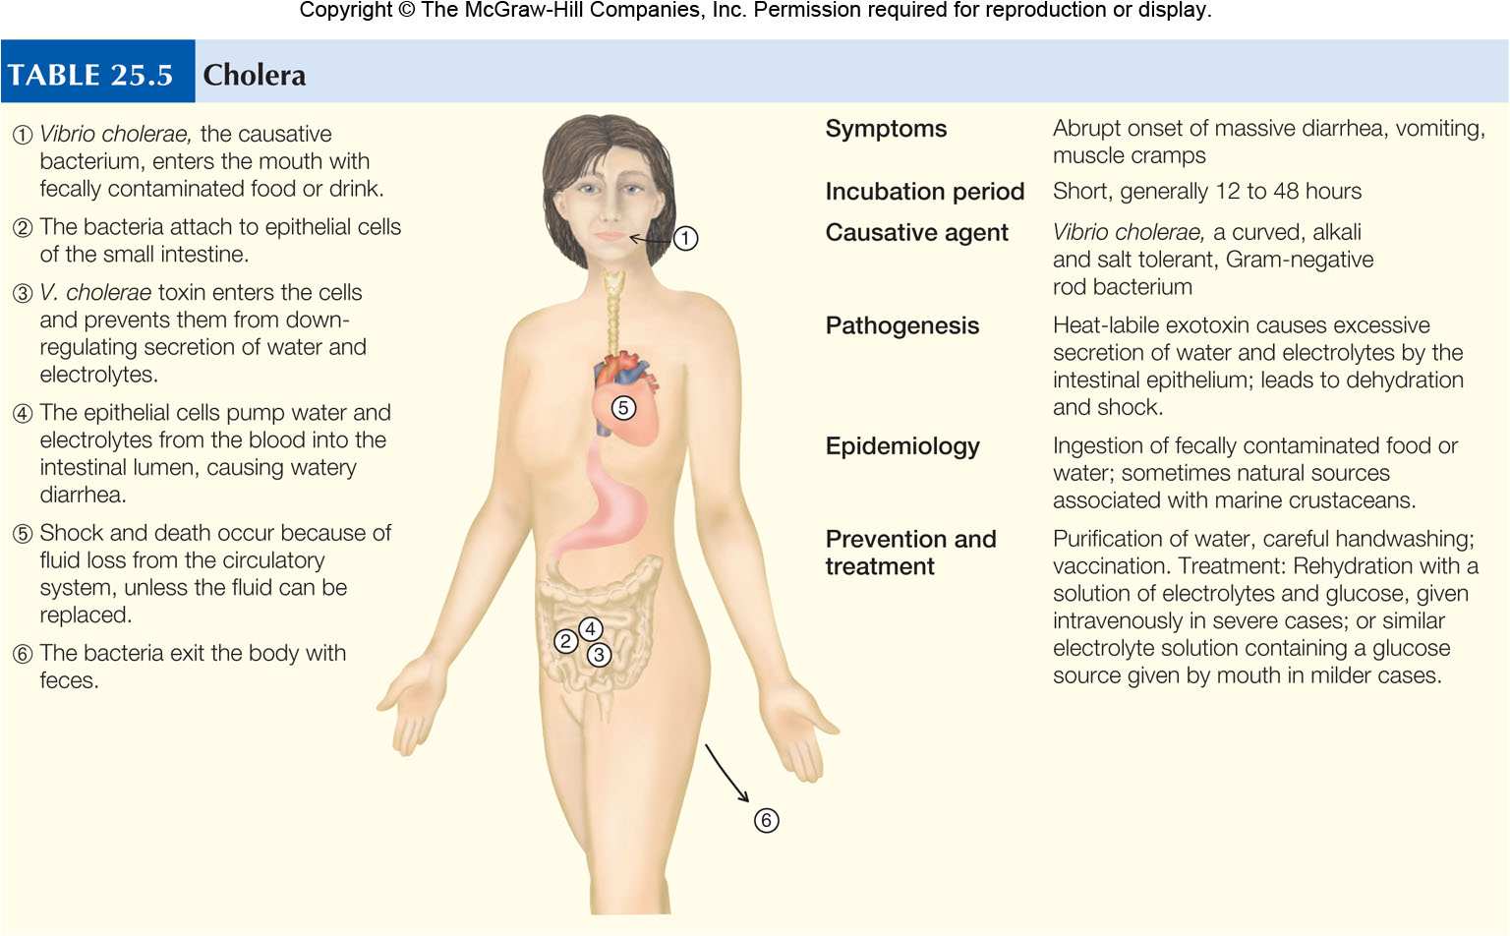
Cholera

Slide 46
Cholera

Slide 47
Shigellosis
Symptoms
Classic symptom is dysentery
Other symptoms include
Headache
Vomiting
Fever stiff neck
Convulsions (rare)
Joint pain
Commonly fatal for infants in developing countries

Slide 48
Shigellosis
Causative Agent - Four species of Shigella
S. flexnuri
S. boydii
S. sonnei
S. dysenterriae
All species can cause shigellosis
What Is Shigellosis?

Slide 49
Shigellosis
Pathogenesis
First step is phagocytosis of bacteria by cells in the large intestine
Cells transport bacteria beneath epithelium
Bacteria adhere to specific receptors near base of epithelial cells
Bacteria multiply at high rate
Pathogenesis
S. dysenteriae
Rarely encountered in United States

Slide 50
Shigellosis
Epidemiology
Generally has a human source of transmission
Transmitted fecal-oral route
Organism not easily killed by stomach acid
Does not have a high infecting dose
As few as 10 organisms
Transmission occurs most often as a result of overcrowding
Also common in day cares and among homosexual men
Contaminated food and water also responsible for outbreaks

Slide 51
Shigellosis
Prevention and Treatment
Controlled by sanitary measures and surveillance of food handlers and water supplies
No vaccine available
Most important treatment is fluid and electrolyte replacement
Antimicrobials often used to shorten duration of symptoms
Also shorten time bacteria discharged in feces
However 20% of Shigella species are resistant to antibiotics of choice

Slide 52
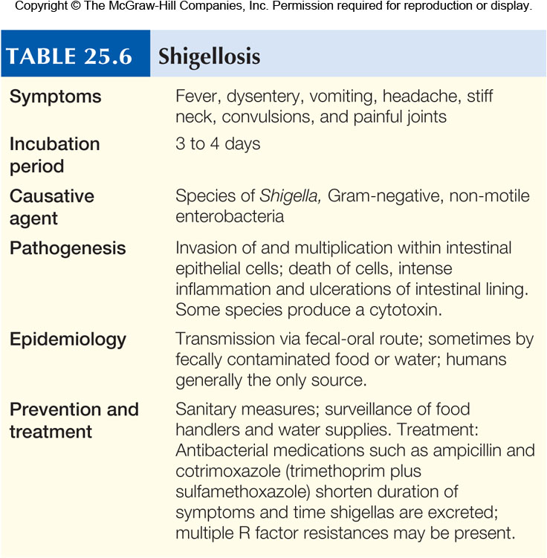
Shigellosis

Slide 53
Escherichia coli Gastroenteritis
Symptoms
Depends largely on virulence of infecting strain
Symptoms can range from vomiting and a few loose stools to profuse water diarrhea to severe cramps and bloody diarrhea
Fever not usually prominent
Recovery usually occurs within 10 days
Pathogenesis
Possesses two important virulence factors
Production of enterotoxin
Adherence to cells of small intestine
Virulence factors foster spread

Slide 54
Escherichia coli Gastroenteritis
Causative Agent
Most diarrhea causing E. coli fall into four groups
Enterotoxigenic E. coli (ETEC)
Most common cause of traveler’s diarrhea
Enteroinvasive E. coli (EIEC)
Disease closely resembles that of Shigella species
Enteropathogenic E. coli (EPEC)
Causes outbreaks in hospital nurseries and bottle fed infants in developing countries
Enterohemorrhagic E. coli (EHEC)
Often produces severe illness due to production of potent group of toxins
Toxins closely related to Shiga toxins
Most common strain O157:H7

Slide 55
Escherichia coli Gastroenteritis
Epidemiology
Epidemics occur from
Person-to-person spread
Contaminated food and water
Unpasteurized milk and juices
Humans, domestic and wild animals all sources of pathogenic strains

Slide 56
Escherichia coli Gastroenteritis
Prevention and Treatment
Prevention directed at
Hand washing
Pasteurization of drinks
Proper food preparation
Treatment includes
Replacement of fluids and electrolytes
Infants may require antibiotics
Antibiotics tend to prolong disease in adults
Traveler’s diarrhea can be controlled with bismuth preparations
Pepto-Bismol

Slide 57
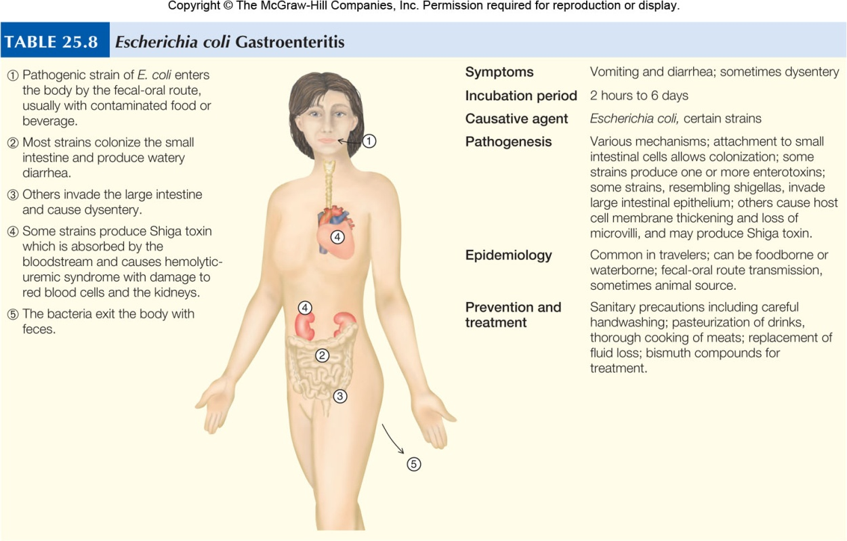
Escherichia coli Gastroenteritis

Slide 58
Salmonellosis
Symptoms
Generally characterized by
Diarrhea
Abdominal pain
Nausea
Vomiting
Fever
Symptoms vary depending on virulence of strain and number of infecting organisms
Symptoms are generally short-lived and mild

Slide 59
Salmonellosis
Causative Agent - Salmonella species
Pathogenesis
Bacteria sensitive to stomach acid
Large number required for infection
Bacteria adhere to receptors on epithelial cells of lower small intestine
Cells take up bacteria through phagocytosis
Bacteria multiply within phagosome discharged through exocytosis
Inflammatory response increases fluid secretion resulting in diarrhea

Slide 60
Salmonellosis
Pathogenesis
Some strains of serotype Salmonella Typhi are not easily eliminated
Organisms cross membrane and resist killing by macrophages
Bacteria multiply within macrophages then carried to bloodstream
Organisms are released when macrophages die and invade tissues
Can result in abscess, septicemia and shock

Slide 61
Salmonellosis
Epidemiology
Bacteria can survive long periods in the environment
Children are commonly infected
Generally by household pets such as turtles, iguanas and baby chicks
Most cases have an animal source
Enteric fevers, such as those caused by Salmonella Typhi are generally the exception
“Typhoid Mary” notorious carrier
Caused at least 53 cases over 15 years

Slide 62
Salmonellosis
Prevention and Treatment
Control depends on reporting cases and tracing source of outbreak
Adequate cooking kills bacterium
Vaccine available for prevention of typhoid fever
Vaccine 50% to 75% effective
Surgical removal of gallbladder eliminates carrier state

Slide 63
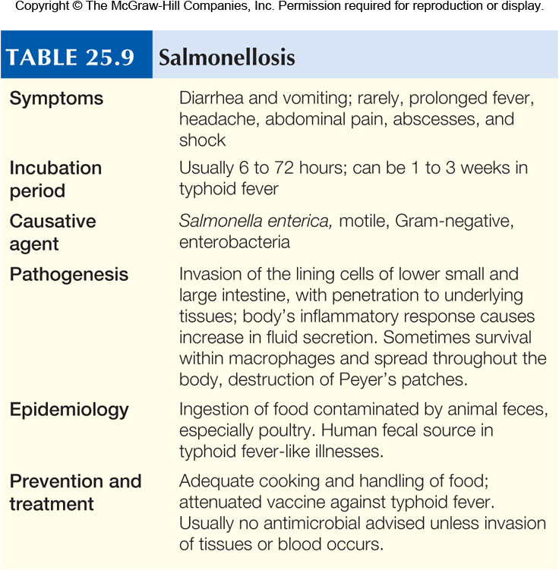
Salmonellosis

Slide 64
Campylobacteriosis
Bacteria recognized in 1972
Leading cause of bacterial diarrhea in United States
Estimated 2.4 million cases annually
Less than 1,000 fatalities
Fatalities mostly in elderly and immunocompromised

Slide 65
Campylobacteriosis
Symptoms
Fever
Vomiting
Diarrhea
Abdominal cramps
Dysentery
Occurs in only about 50% of cases
Causative Agent - Campylobacter jejuni

Slide 66
Campylobacteriosis
Pathogenesis
Small infecting dose
Only 500 organisms required to initiate disease
Organisms penetrate intestinal epithelium
Bacteria multiply in and under cells and initiate inflammation
Sequel of disease is Guillain-Barré Syndrome
Begins abruptly within about 10 days of onset of diarrhea
Tingling of the feet leads to progressive paralysis of the legs, arms and rest of body
Most patients require hospitalization
80% recover completely, 5% mortality despite treatment

Slide 67
Campylobacteriosis
Epidemiology
Numerous foodborne and waterborne outbreaks have been reported
Most cases sporadic
Causative agent lives in intestine of variety of domestic animals
Particularly poultry
One drop of juice from raw chicken can contain infective dose
Epidemics have occurred due to unpasteurized milk
Person-to-person spread rare

Slide 68
Campylobacteriosis
Prevention and Treatment
Prevention directed at proper treatment of water and food
Pasteurization of drinks and proper cooking and handling of raw food
Most cases of campylobacteriosis subside without antimicrobial treatment in about 10 days
Erythromycin recommended for severe cases

Slide 69
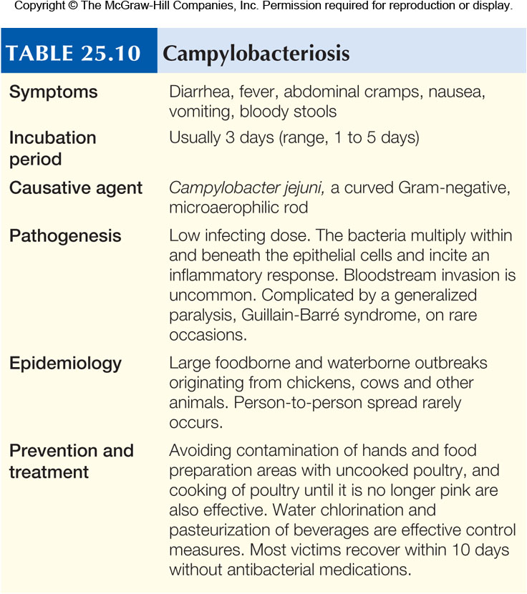
Campylobacteriosis

Slide 70
Hepatitis A
Symptoms
Fatigue
Fever
Loss of appetite
Nausea
Right side abdominal pain
Dark-colored urine and clay colored feces
Jaundice
Children less than 6 years old are generally asymptomatic nearly 70%
20% of adults require hospitalization
Full recovery in about 2 months
Formally called infectious hepatitis

Slide 71
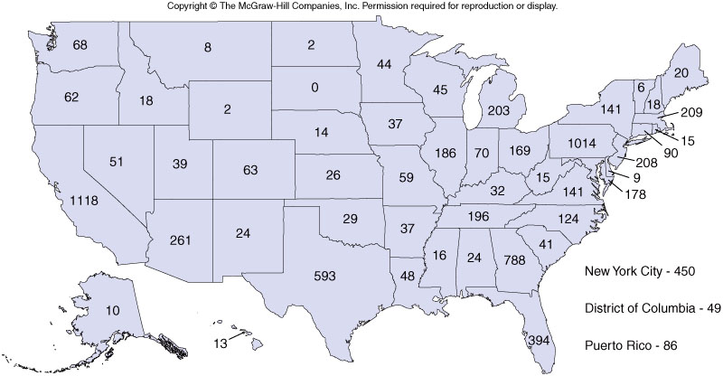
Hepatitis A
Insert Figure 25.18

Slide 72
Hepatitis A
Pathogenesis
Transmission from ingestion of contaminated food or water
Ingested virus reaches liver by unknown route
Liver main site of viral replication
Only tissue know to be damaged
Virus is released into bile
Virus-laden bile eliminated in feces

Slide 73
Hepatitis A
Epidemiology
Spreads via fecal-oral route
Many outbreaks originated from restaurants
Due to infected food handler
Raw shellfish frequent source of infection
Low socioeconomic groups make up high percentage of infected
High risk groups include people in day care and nursing homes and homosexual men

Slide 74
Hepatitis A
Causative Agent - Hepatitis A virus (HAV)
Prevention and Treatment
Vaccine available since 1995
Indicated for travelers to deprived regions, homosexual men, sewer workers and healthcare workers
Gamma globulin contains HAV antibody, can be given to individuals that have been exposed
Afford short term protection if given within 2 weeks of exposure

Slide 75
Hepatitis B
Symptoms
Similar to hepatitis A
Symptoms for hepatitis B more severe
Causes death in 1% to 10% of hospitalized cases
Formerly known as serum hepatitis
Causative Agent - Hepatitis B virus (HBV)

Slide 76
Hepatitis B
Pathogenesis
HBV carried in liver
Mechanism of liver damage unknown
Damage most likely results from immune response
Virus replicates via reverse transcriptase
Viral DNA transported to host nucleus
Host mRNA makes RNA copy
RNA copy transcribed by viral reverse transcriptase
New DNA copy is genome for new virus
New viruses bud from host cell

Slide 77
Hepatitis B
Epidemiology
Progressive rise in reported cases between 1965 and 1985
Incidence appears to have plateaued
HBV spread mainly by blood, blood products and semen
Carriers are of major importance
Often unaware of infection

Slide 78
Hepatitis B
Epidemiology
Risk factors for infection include
Sharing needles
Tattooing and piercing with contaminated instruments
Shared toothbrushes, razors and towels
Sexual intercourse responsible for nearly 50% of cases in United States

Slide 79
Hepatitis B
Prevention and Treatment
Vaccine approved in 1980s
New more effective vaccine available since 1986
Vaccination against HBV can help prevent liver cancer caused by the virus
Passive immunization with HBIG (hepatitis B immune globulin) offers immediate protection
No curative treatment
Hepatitis B

Slide 80
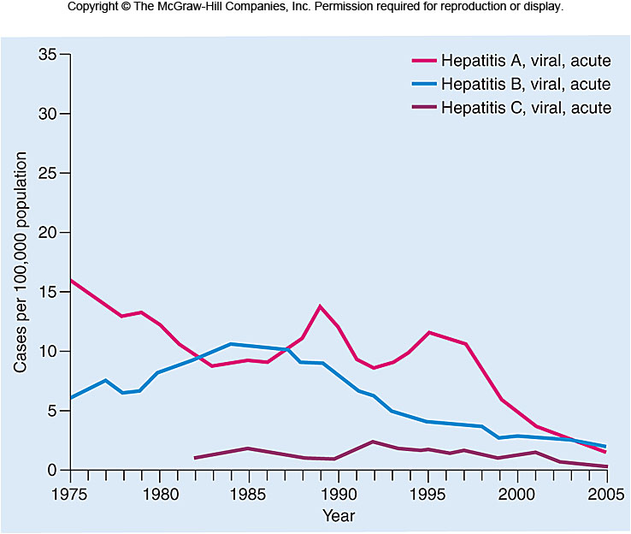
Hepatitis B

Slide 81
Hepatitis C
Symptoms
Same as hepatitis A and hepatitis B
Generally milder
65% are asymptomatic
25% have jaundice
Causative Agent - Hepatitis C virus

Slide 82
Hepatitis C
Pathogenesis
Few details known
Infection transmitted via contact with infected blood
Incubation period average 6 weeks
Over 80% develop chronic infections
Virus infects the liver
Incites inflammatory and immune responses
Disease comes and goes
Individuals have times of near normalcy
10% to 20% will develop cirrhosis or liver cancer

Slide 83
Hepatitis C
Epidemiology
Mechanism of exposure not always obvious
Risk factors include
Sharing toothbrush, razors, towels
Tattooing and piercing with unclean instrument
Sharing syringes
60% of US cases due to sharing needles
Transmission via intercourse most likely rare
Can occur if multiple partners

Slide 84
Hepatitis C
Prevention and Treatment
No vaccine for HCV
Vaccination against A and B seem to give some protection
Avoidance of alcohol to limit effect on liver
No satisfactory treatment
Some are helped by interferon therapy
Hepatitis C

Slide 85
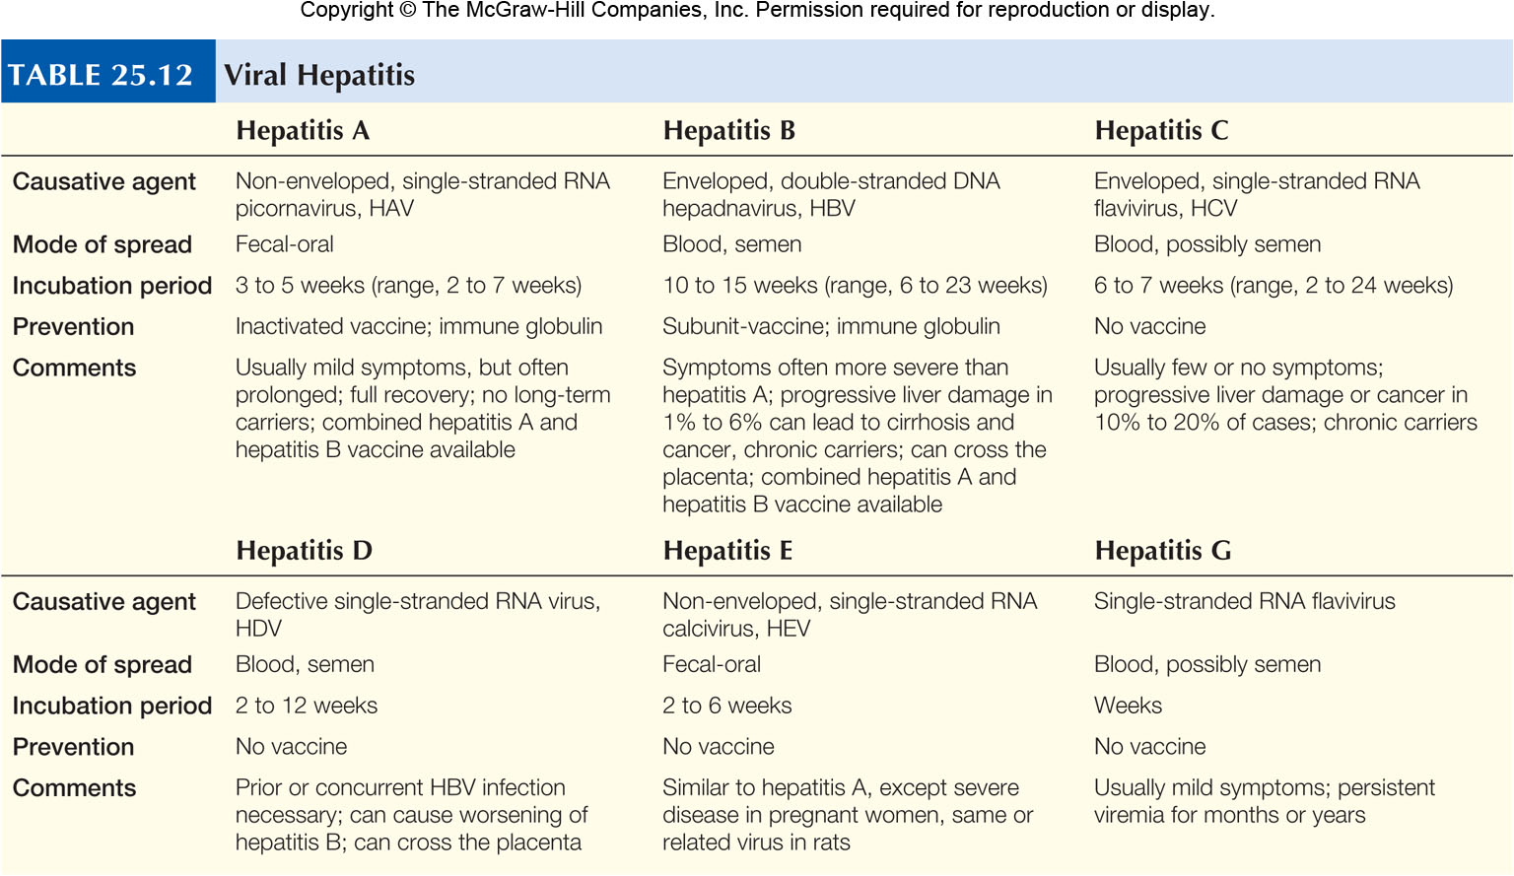
Hepatitis C

Slide 86
Giardiasis
Symptoms
In epidemic approximately two-thirds of exposed individuals develop symptoms
Incubation period 6 to 20 days
Symptoms range from mild to severe
Indigestion and nausea to vomiting and explosive diarrhea
Symptoms usually disappear within 4 weeks
Some cases become chronic

Slide 87
Giardiasis
Causative Agent - Giardia lamblia
Pathogenesis
Cyst responsible for infection
Due to fact they resist stomach acid
Trophozoits attach to epithelium of small intestine and move to large intestine
In severe cases, organism may cover entire intestinal surface
Interfere with proper functioning of intestine
Results in malnutrition, bulky feces and excess gas

Slide 88
Giardiasis

Slide 89
Giardiasis
Epidemiology
Single human stool can carry 300 million cysts
Only 10 required for infection
Cysts can survive in cold water up to 2 months
Chlorination often ineffective against cysts
Filtration required
Transmission risk increases with risky behavior
Anal and oral sex
Transmission usually via fecal-oral route
Particularly in contaminated water
Sources of organism include
Beavers, raccoons, muskrats, dogs, cats, humans

Slide 90
Giardiasis
Prevention and Treatment
Filtration of water
Organisms sensitive to heat
Boil water 1 minute before using
Good hygiene practices

Slide 92
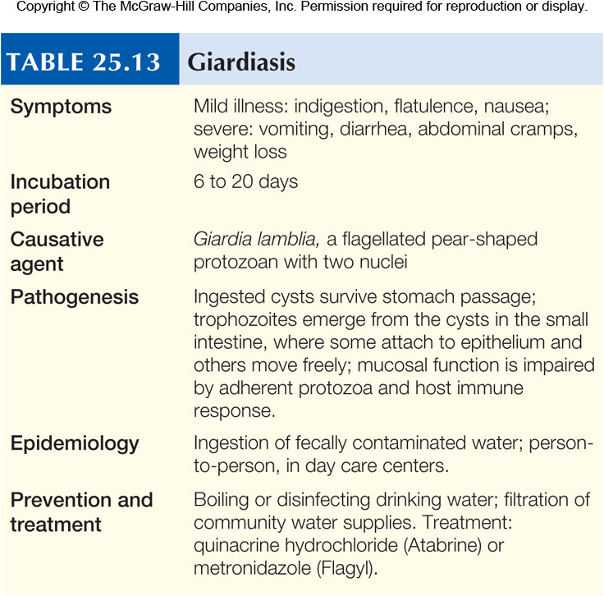
Giardiasis

Slide 93
Amebiasis
Symptoms
Commonly asymptomatic
Symptoms range from chronic diarrhea to acute dysentery and death
Causative Agent
Entamoeba histolytica
Pathogenesis
Infection begins with ingestion of mature cysts
Organisms released from cyst in small intestine
Feed non intestinal mucus and bacteria
Some strains produce toxic enzyme which kills epithelium and can lead to abscess

Slide 94
Amebiasis
Pathogenesis
Irritating effect of feeding organisms causes intestinal cramps
In presence of intestinal ulceration diarrheal fluid is often bloody
This condition referred to as amebic dysentery

Slide 96
Amebiasis
Epidemiology
Distributed worldwide
More common in tropical areas
Human only reservoir
Transmission fecal-oral route
Mainly associated with poverty, male homosexuality and migrant workers
Prevention and Treatment
Depends on
Sanitary measures
Avoiding fecal contamination of food and drinking water
Metronidazole, paromomyacin are effective treatments

Slide 97
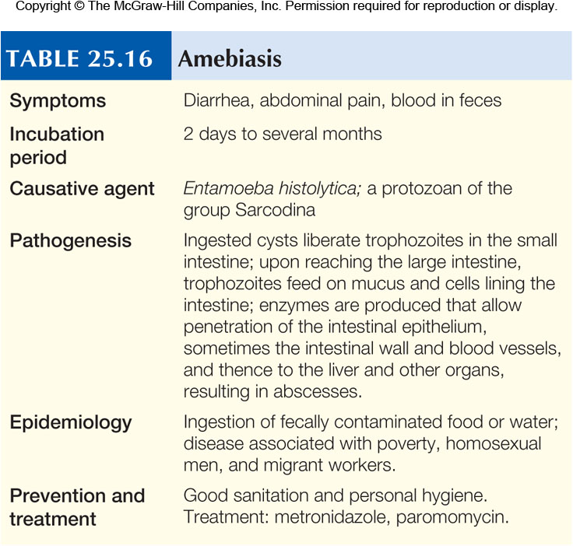
Amebiasis

